Slide 1
Water Conservation Seminar
Thursday, February 2, 2023

Slide 2
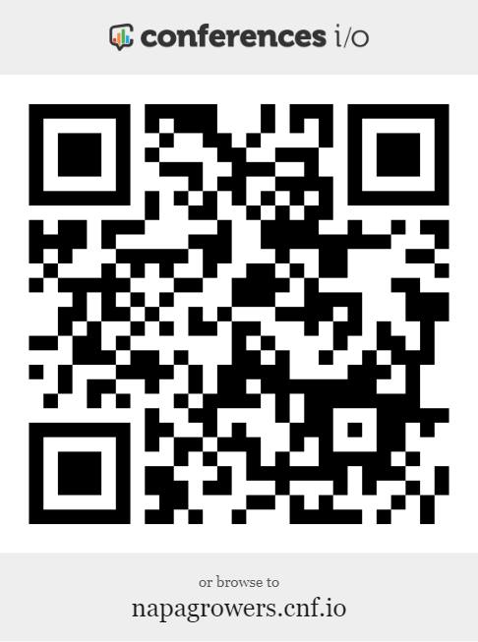
Online Q&A and Evaluation
Open the camera app on a mobile device and point it at the QR code. If the device supports active QR code reading, a prompt to access the URL should appear.
Here you can submit questions anytime and complete the event evaluation.

Slide 3
Presentation Title
Speaker Name
Company

Slide 4
Presentation Slide
Copy or bullet points:
Copy or bullet points
Copy or bullet points
Copy or bullet points
Copy or bullet points

Slide 5
Presentation Slide
Copy or bullet points:
Copy or bullet points
Copy or bullet points
Copy or bullet points
Copy or bullet points

Slide 6
Presentation Title
Up Next…
Speaker Name
Company

Slide 7
Presentation Slide
Copy or bullet points:
Copy or bullet points
Copy or bullet points
Copy or bullet points
Copy or bullet points

Slide 8
Presentation Slide
Copy or bullet points:
Copy or bullet points
Copy or bullet points
Copy or bullet points
Copy or bullet points

